Slide 1

Capstone Presentation
Secure Quantum Communication Using BB84 Protocol Enhanced with AI-based Error Correction and Visualization
Shravan Aswale, Atharv Gadge, Astha Chopde
Sem: VI
Under the guidance of
Prof. Rajeshwar Balla
Symbiosis Institute of Technology, Nagpur Campus

Slide 2


Innovative Practices & Quality Initiatives at SIT-N
01
Introduction and Problem Statements
Presentation Flow
Conclusion and references
02
04
Objectives
Methodology
* Key Findings and result
03

Slide 3
INTRODUCTION
Project Title: Secure Quantum Communication Using BB84 Protocol Enhanced with AI-based Error Correction and Visualization
Problem Statement: Quantum Key Distribution Protocols
Classical cryptography relies on hard math problems.
Quantum computers can break those (like RSA).
We need future-proof encryption.
Quantum Key Distribution (QKD) uses physics instead of math.
BB84 Protocol allows two people to share keys securely using quantum bit

Slide 4
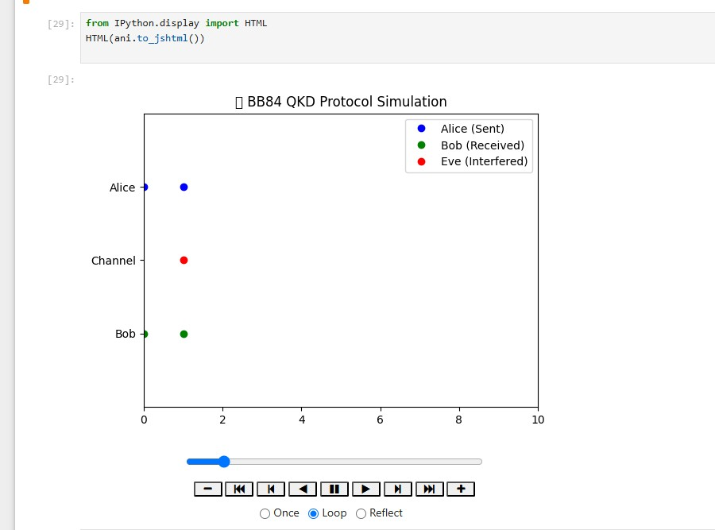
Project Objectives
Simulate BB84 Protocol using Python
Create an AI model for error detection and correction
Visualize key exchange, eavesdropping, and recovery
Animate bit transmission process
Bit | Basis (Alice) | Photon sent
1 | +
0 | *
1 | *
0 | +
Basis (Bob) | Measurement Result
+(match) | Correct(1)
+(wrong) | Random bit
*(Match) | Correct(1)
*(wrong) | Random bit

Slide 5
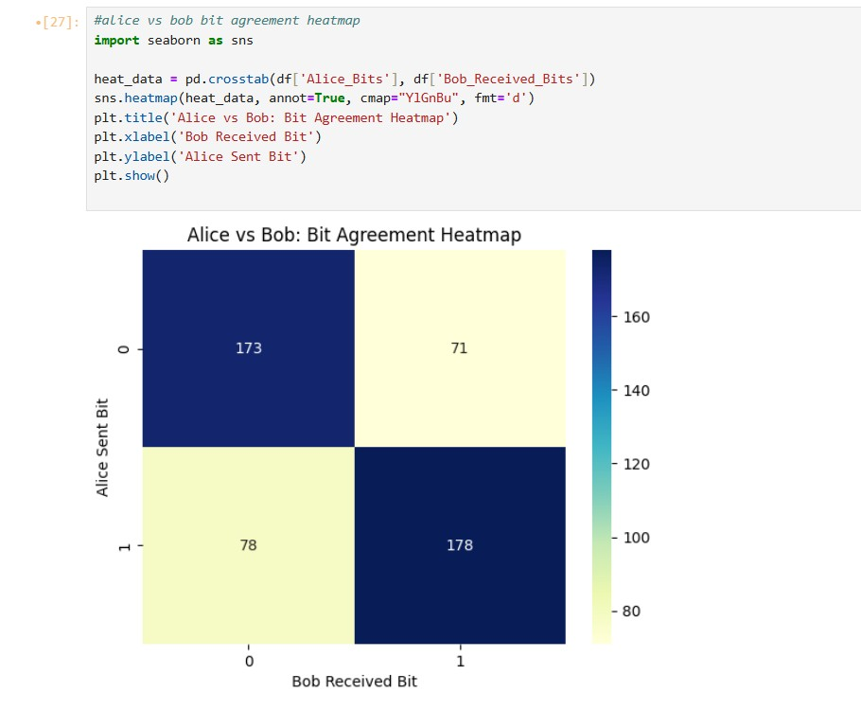
Methodology
Generate Alice's and Bob’s bits and bases
Simulate Eve’s interference (30% probability)
Add noise and errors to Bob’s bits
Construct dataset of quantum transmission
Train AI model to recognize and fix errors
Networking Concepts:
Handshaking in QKD
TTL(time to live) in Quantum Simulation and RTT (Round trip Time)as measured in simulation

Slide 6
Key Takeaways
Quantum safety: Quantum rules help us build super secure communication systems.
BB84 Protocol: A basic quantum method for sharing secret keys safely.
Catch the hacker: If someone tries to spy (like Eve), we can detect it easily.
AI helps: Machine learning can fix transmission errors and improve the system.
Fun learning: Visual tools make quantum topics easier and more interesting.
Future-ready: QKD can protect us even when powerful quantum computers arrive.

Slide 7
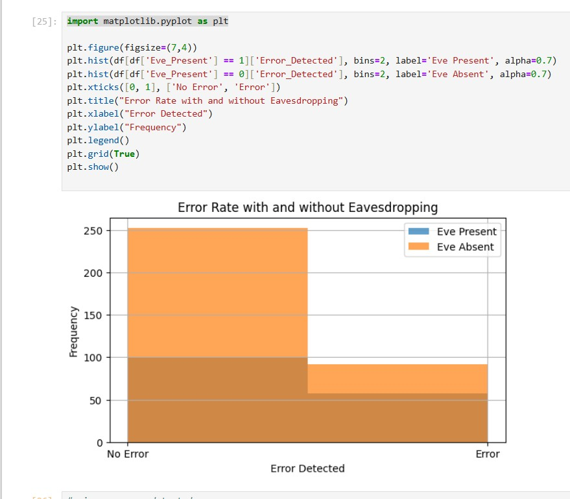
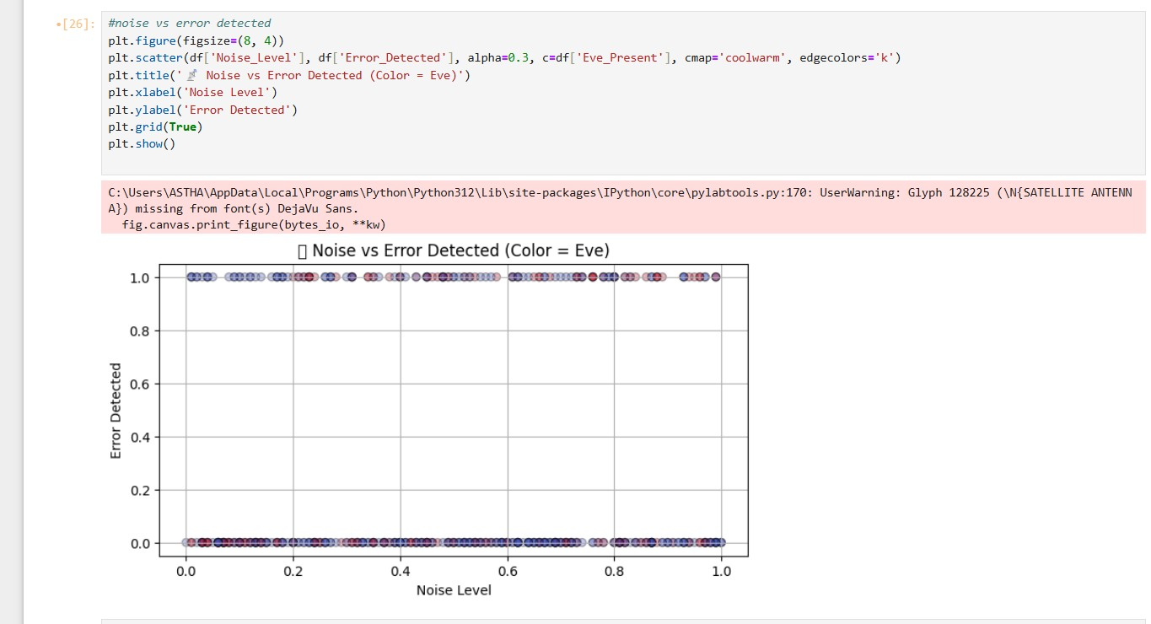
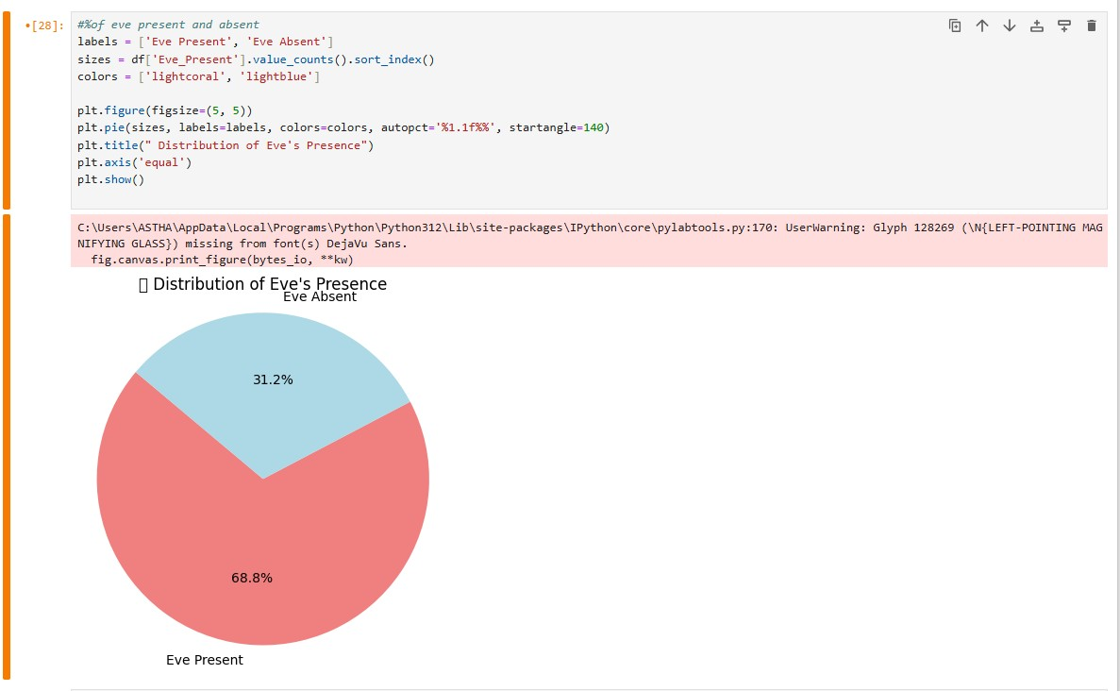
Results
Visuals: Animated bit flow and protocol visualization
Insights: BB84 can detect eavesdropping easily

Slide 8
Conclusion
Quantum Key Distribution ensures future-safe encryption.
The BB84 protocol is effective even with eavesdropping attempts.
AI enhances QKD by correcting quantum errors.
Visual tools improve the understanding and presentation of quantum communication.
Ready for real-world application in quantum-secure networks.
Future Enhancements:
Hardware Implementation Possibilities
Real-Time QKD on Quantum Networks
Advanced AL models (eg, LSTM, CNN)

Slide 9
References
Bennett, C. H., & Brassard, G. (1984). Quantum cryptography: Public key distribution and coin tossing. Proceedings of IEEE International Conference on Computers, Systems and Signal Processing.
Qiskit Documentation: https://qiskit.org/documentation/
Cirq Documentation: https://quantumai.google/cirq
Nielsen, M. A., & Chuang, I. L. (2010). Quantum Computation and Quantum Information.
IBM Quantum Experience: https://quantum-computing.ibm.com/
Scikit-learn: https://scikit-learn.org/
TensorFlow Documentation: https://www.tensorflow.org/

